Slide 1
Neo4j Deployment Success: Getting Started
Onboarding Kickoff

Slide 2
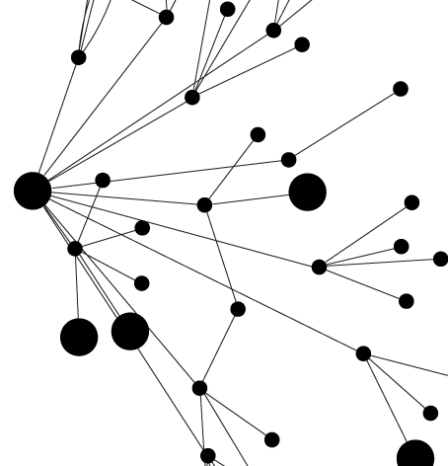
Kick-off Meeting Agenda
Introductions
Understanding the project
Checklist of Topics Offered During Onboarding
Priority Items
Burning Questions?
Engaging Support
Next Steps

Slide 3
Understanding the Project
How are you using Neo4j?
Business Challenge and Use case(s)
Data model (share diagram later?)
Types of queries (what are the primary questions you ask the database?)
Any other databases used alongside Neo4j? (Polyglot model?)
How are you connecting to the graph? (Bolt Drivers vs. REST, Cypher vs. Core API, etc.)
Who are the end users (of Neo4j or the application)?
How big is the graph?
Now?
Future?
Note: # Nodes, # Relationships, # Properties
Or size, output of :play sysinfo in Browser

Slide 4
Understanding the Project
What environments do you have currently? Future?
Current Neo4j versions of each
Clustered? (CC or HA) LB or Proxy?
If clustered, multiple DCs or regions? Is there a DR requirement?
What is the expected read/write workload on prod?
How often is data loaded and/or updated?
What are the specs of the systems you have Neo4j installed on?
Bare metal, virtual, cloud (AWS, etc)?
OS
# of CPU cores
RAM
Disks
Java (version and distribution [OpenJDK, Oracle, IBM])

Slide 5
Understanding the Project
When did you start using Neo4j on this project?
Any significant challenges to-date?
What is the project timeline?
Production go-live
Next steps after the initial launch?
Other use cases forseen?

Slide 6
Checklist of Topics Offered During Onboarding
Note: These topics are covered in detail in the Customer Success Handbook: https://support.neo4j.com/hc/en-us/articles/217513118
Install and Upgrade
Tuning and Configuration (Memory, Cache, JVM)
Clustering / DR
Proxy Servers / Load Balancing
Backup and Restore
Cypher Tuning
Indexing
Concurrency and Isolation
Monitoring
Importing data
Logging and Common Errors (what to collect when debugging)

Slide 7
Priority Items
Top items to review now or ahead of Technical Review:
Make sure JVM init and max heap is set
Start with 6-8GB, increase or decrease after monitoring during load testing
Should be same value as well (init = max) to prevent long GCs
Make sure page cache is set
:play sysinfo in Browser to see what current store size is
Set this to store size + 10% if possible
Leave 3-5GB for OS and Lucene caching
Identify whether you are seeing long GCs, and take action
grep blocked debug.log
For anything over a couple seconds, let’s review
If you are running a cluster, make sure it is configured properly
Technical Review to cover this
Know how to take backups and restore the database
Make sure pre-production is identical to production setup

Slide 8
Burning Questions? (technical or otherwise?)

Slide 9
Support
Notes:
Faster import (quantify)
Faster writes (quantify)
Faster Cypher (quantify)
....even faster for EE (quantify)
More utilized clusters (higher throughput) (quantify)
Bigger graphs
So what....?

Slide 10
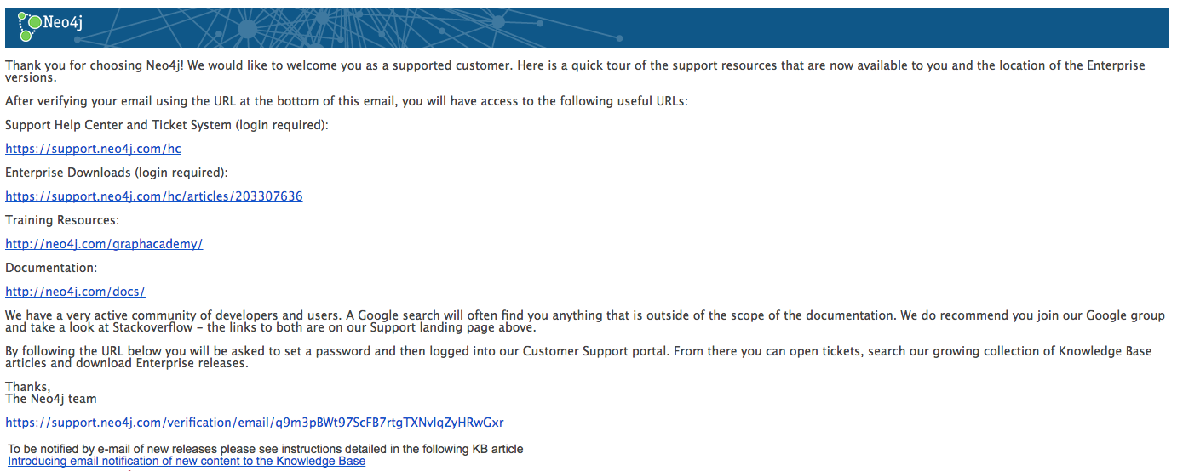
New Support Account Email
← Click this link to verify & set a password

Slide 11

Engaging Neo4j Support
Log a ticket, download Enterprise software, and search the KB:
https://support.neo4j.com/login
Note: You will receive an email asking you to verify your account, which has links to useful information. We recommend exploring that.
Search the Knowledgebase first:
You can subscribe to Support Notifications to be updated when new releases become available.
https://support.neo4j.com/hc/en-us/articles/214578257
Include as much info as possible when opening the ticket.
Be sure to report the time the issue started occurring!
We will almost always need the debug.log file from each instance in the cluster. Please provide that when opening a ticket in addition to anything else you believe will help.

Slide 12
Engaging Neo4j Support (continued)
SLAs:
Standard Support: Sev 1 = 1 hour response (local business hours), Sev 2 = 4 hour response (local business hours), Sev 3 and 4 = 8 hour response
Premium Support: Same as Standard except Sev 1 = 1 hour response (24x7x365).
Support / patch schedule:
Per our support terms, we support patching a release for 18 months after it is released. In simpler terms:
We aim to release 2 major/minor versions of Neo4j yearly (spring and autumn)
We actively patch the current and previous version.
Thus: We recommend you plan to take an upgrade yearly. Plan in advance to allow time for testing and any refactoring needed.
Remote assistance: We use GoToMeeting for screen-sharing during support troubleshooting when this is needed. If you have a different screen-share, we will use that (Webex, etc).
It might be a good idea to make sure that anyone on your end who might open a high priority ticket have the ability to use GoToMeeting or initiate your company’s preferred screen-sharing program.

Slide 13
Next Steps
Notes:
Faster import (quantify)
Faster writes (quantify)
Faster Cypher (quantify)
....even faster for EE (quantify)
More utilized clusters (higher throughput) (quantify)
Bigger graphs
So what....?

Slide 14
Next Step #1: Technical Review
Please send us your configuration and log files.
conf/* (neo4j.conf, neo4j-wrapper.conf (if prior to Neo4j 3.2.x))
logs/* (debug.log, neo4j.log, queries.log, http.log, etc)
We will review offline, and then share findings in a follow-up call
Other items we should review:
Linux Open Files: https://neo4j.com/docs/operations-manual/3.1/installation/linux/tarball/#linux-open-files
Linux Tuning: https://neo4j.com/docs/operations-manual/3.1/performance/linux-file-system-tuning/
Ports to open: https://neo4j.com/docs/operations-manual/3.1/configuration/ports/
Review Security Checklist: https://neo4j.com/docs/operations-manual/3.1/security/checklist/

Slide 15
Next Step #2: Schedule Healthcheck
We want to establish a cadence with your team.
Let’s shoot for once a quarter, unless you need it less often.
Items to review during healthcheck:
Current project status and future plans
Review any open tickets or questions
Option to review roadmap
Discuss upgrade plans/options

Slide 16
Intro to Neo4j (Training and Materials)
Self-paced learning:
http://neo4j.com/graphacademy/online-training/
Resources available on Neo4j.com:
http://neo4j.com/developer/get-started/
http://neo4j.com/blog/
http://graphgist.neo4j.com/#!/gists/all
http://neo4j.com/docs/stable/
Videos:
http://graphconnect.com/?_ga=1.87701912.1639125439.1429650424

Slide 17
Tips on playing with neo4j
If you break it, move/remove graph.db and restart
A new clean database is built for you
You can spin up a test cluster on a single MAC/PC
Instructions in the HA section. http://neo4j.com/docs/operations-manual/3.0/tutorial/local-cluster/
You can move between databases by stopping and changing neo4j.conf to point at the relevant store directory.
There are lots of great blogs by Neo4j Staff
http://neo4j.com/developer/resources/
Google search will find examples.
StackOverflow, Google Group, blog posts, community posts etc.
Public Slack Channel:
https://neo4j-users.slack.com

